Slide 2
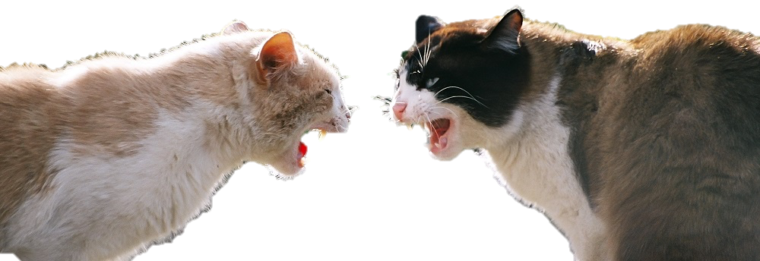
“Is He/SHE more competent than me?”
(too stressful to think about it…)

Slide 3


natural experiment
natural experiment of intergroup competition
unobtrusive observation of “group talk”

Slide 4
end of game
WIN
LOSE
‘Talk’
Posemo
Angry
sadness
anxiety

Slide 5
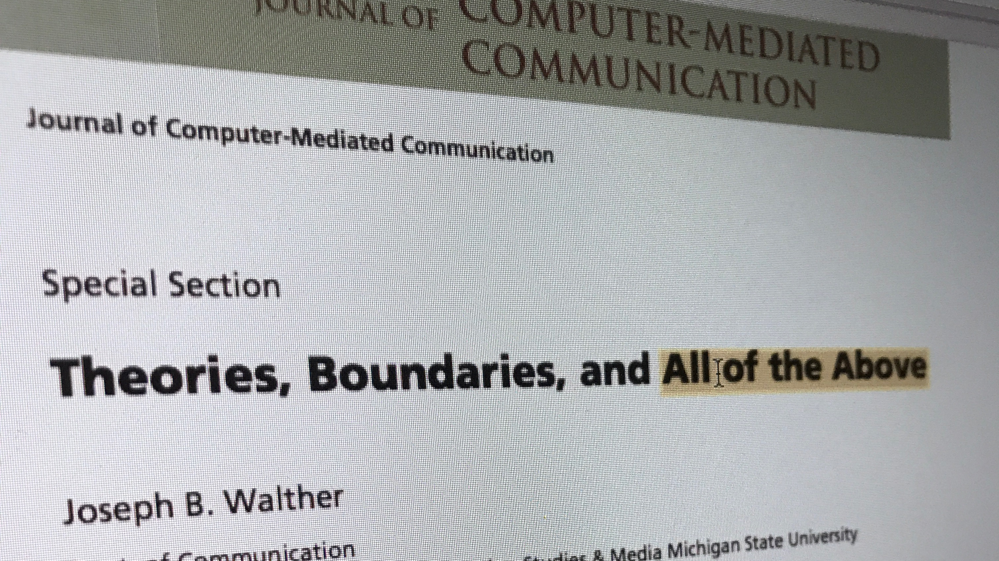
multilevel channel effects?
cues-filtered out (in group process)
social info processing / hyperpersonal
social identity model of individualization
or…

Slide 6
communication channel / technology
as multilevel moderator
ACTOR
Inter-personal Cognition or Behavior
intra-
group
PARTNER
RELATION-SHIP
inter- group
Social Relations Model
Intergroup SRM

Slide 7
relative performance expectation
perceived status (expertise)

Slide 8
relative performance expectation
perceived status (expertise)
–
–
communication accommodation

Slide 9
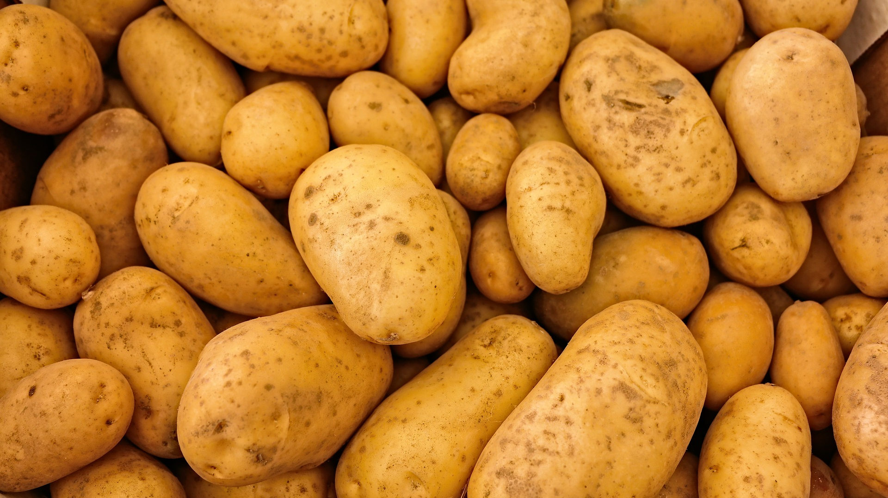
sharing risk information with “outsiders”?

Slide 10
Which internal structure promotes / suppresses external sharing?
collective agent
joint production of collective goods

Slide 11
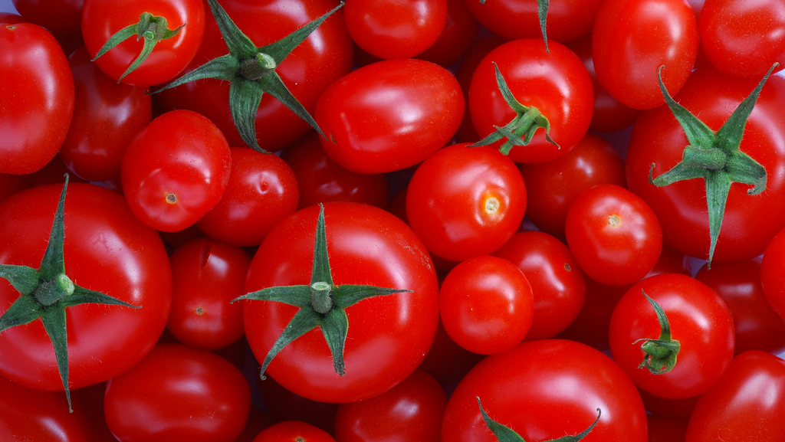
sharing risk information with “insiders”?

Slide 12
Which concern
promotes / suppresses internal sharing?
time & effort
economic cost & benefit
individual
interpersonal trust
dyadic reciprocity
relationship
individual
sense of cohesion
sense of shared responsibility
collective

Slide 13
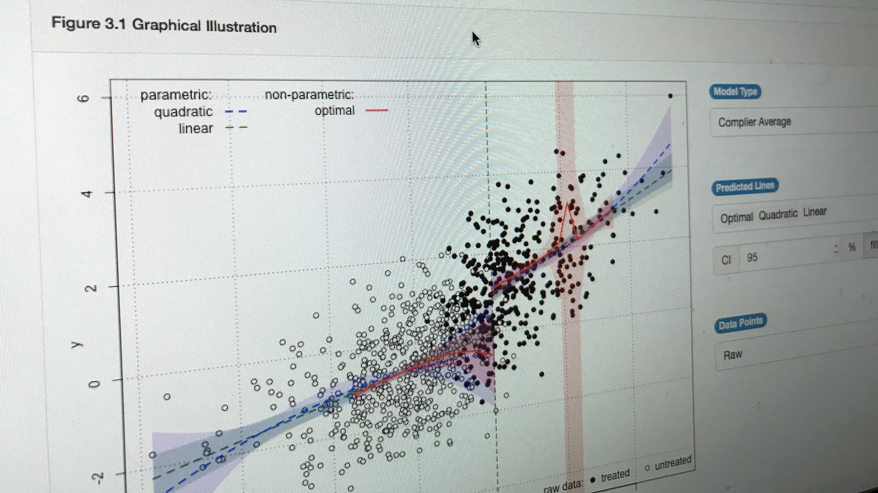

Slide 15
